Slide 1
Kernel Maze Analysis
Zoe DeSouza

Slide 2
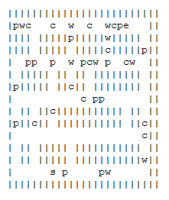
Moving the cells
As seen in the photo on the side, moving a larger number of cells (in this case, 3) clears out almost entire rows.
Though I did not attempt it, I believe that if the number of cells moved were to be randomized, different amounts of cells would be cleared in different directions (after each direction was exhausted)- however it would take more work to implement

Slide 3
Different Graph Search Algorithms
BFS
BFS was used to create the end point of the maze
However, in comparison to A* Algorithm, BFS is less efficient: it explores all neighboring vertices before continuing
BFS is more efficient in this case than DFS, which would follow each path to its end (we already know a path exists, the shortest route is what we want)
A* Algorithm: Manhattan Heuristic
A* looks for a target with an implemented heuristic which determines the likely distance remaining
A* is more efficient due to its ability to estimate distances
The Manhattan heuristic would be utilized in the Kernel Maze because the distance cannot be diagonal

Slide 4
Storing & Sorting Swag
To be honest, I am not entirely sure how it might be stored.
However, perhaps it is possible to store it in a ‘visited’ dictionary, where the coordinates are followed by the cell type. Otherwise, it might be possible to only add items to a new empty list if they are != ‘wall’, ‘empty’, ‘start’, ‘end’
Assuming a much larger list of swag, I would decide either on Quicksort or Radix Sort. Radix sort has a lower worst case runtime complexity, but it uses numbers, so the swag types would have to be assigned different numbers. Other potential algorithms (like bubble sort) were discarded because the runtime would be exponentially worse as the number of inputs increased. I did not find a large difference in variety that would make me pick RadixSort or Quicksort over one another.

